Slide 1
WRZ introduction
14th March 2023

Slide 2
WR demo Nokia
14th March 2023

Slide 3
Agenda
01
04
|
|
White Rabbit technology
Use cases
02
05
|
|
WRZ family overview
Best practices
03
|
Management tools

Slide 4
01
White Rabbit technology

Slide 5
Introduction
Accuracy
Relationship between the result and the correct value
Precision
The degree of repeatability of different results of the time

Slide 6
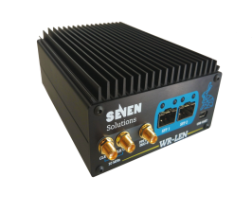
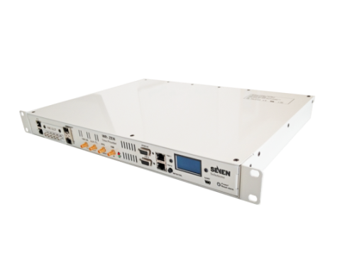
White Rabbit goals
Born at CERN, Next IEEE-1588-2019 HA standard
Stable and validated ecosystem
Easy to integrate into existing
telecom networks
(Ethernet, PTPv2, NTP)
Scalable
to long distances and number of nodes
Highly accurate
Sub-ns performance. Time transfer without impact in time error budget
New applications
Mobile-based cm-range indoor/outdoor positioning as GPS alternative
Support Blockchain scalability
Resilient
No GNSS vulnerabilities. Performance is not affected by data traffic
Cost-effective
Easy to deploy, self-calibration

Slide 7
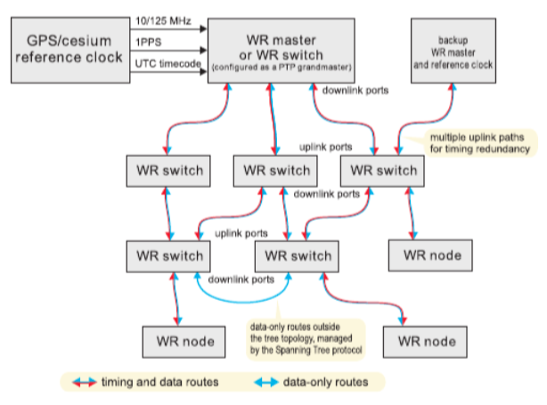
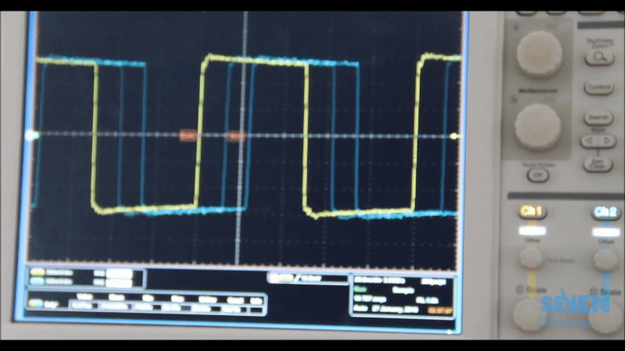
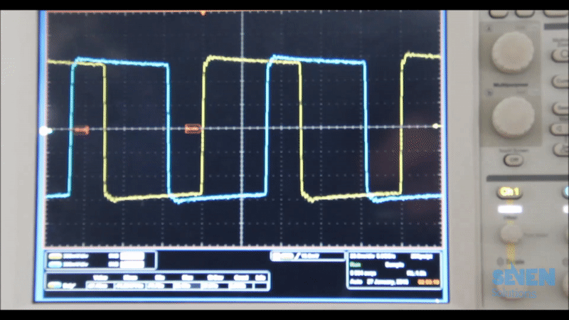
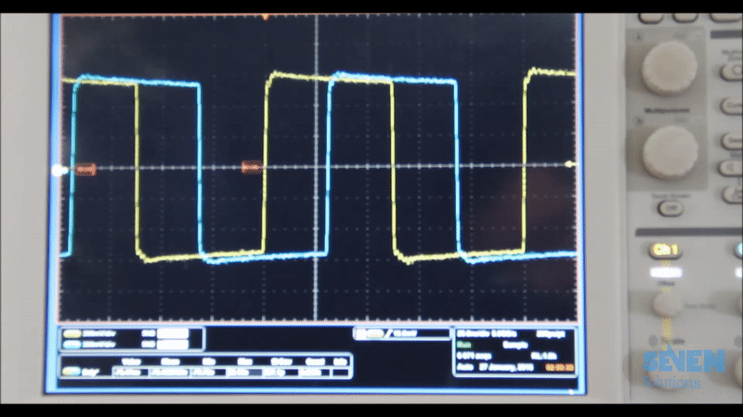
WR basic hierarchy: GM, BC & Slaves
Syntonization – Sync E
Synchronization – Enhanced PTP
Frequency is the time ruler. PPS provide just initial phase relationship: PPS - 10MHz signals may drift
All devices must be WR-compliant for sub-nanosecond accuracy. However, other PTPv2 or just Ethernet devices can be connected to the network without achieving WR synchronization performance
Boundary clock behavior. Scalability driven by the number of ports

Slide 8
Synchronization: L1 syntonization & PTP (IEEE-1588v2)
White Rabbit measures the offset between devices taking into account fixed and dynamic variations due to weather conditions using picosecond level accurate timestamps
Timestamp generation based on frequency mixing techniques: Clock phase measurement
WR master
WR slave
The timestamps are capable of measuring time difference and phases of two digital clock signals with very fine resolution (sub-picosecond) and they are used to adjust the received and generated clock offset

Slide 9
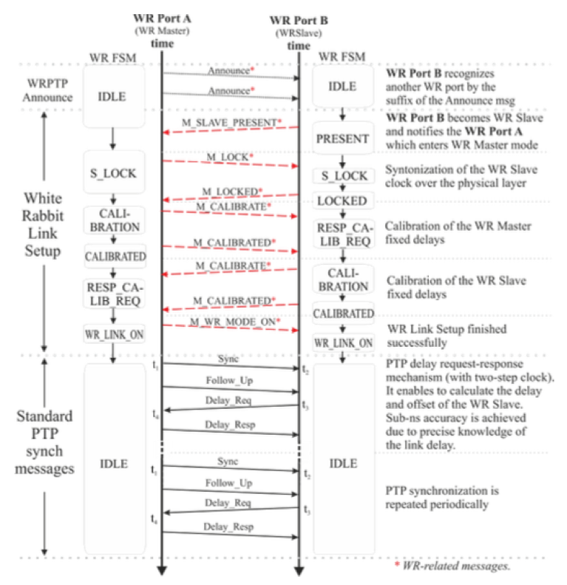
Time transfer: WR-PTP
White Rabbit uses the information collected by the exchange of timestamped packets for correcting the constant offset between nodes
The information from the calibration is also important for compensating the static offset between nodes

Slide 10
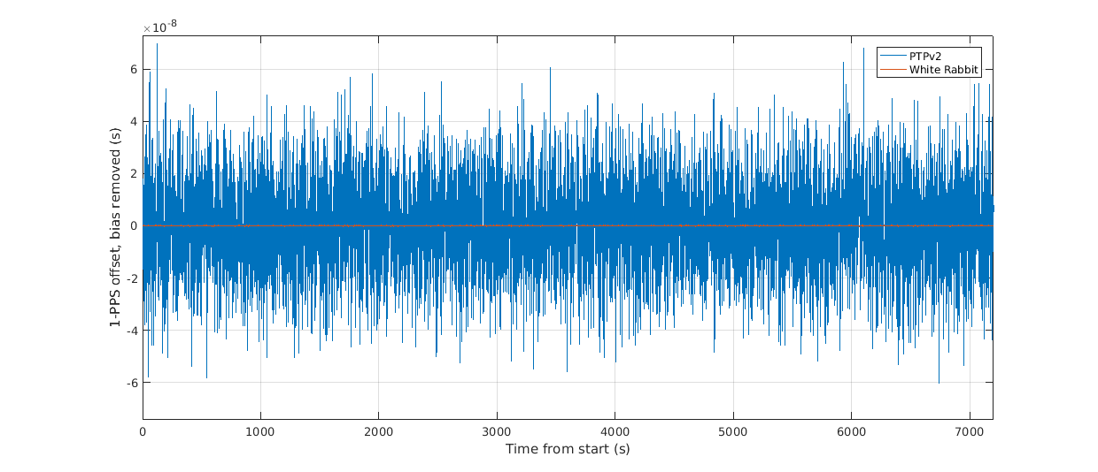
WR vs PTP accuracy

Slide 11
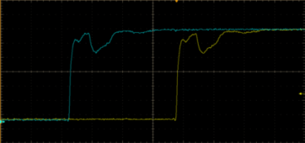
Pre-calibration
White Rabbit uses single fiber WDM (typically BiDi SFP 1310/1490 nm and single-mode fiber G652) to avoid link asymmetries caused by different propagation velocities on the downstream and upstream links
BiDi SFPs use different wavelengths tx and rx, which means slight disparities in propagation of speed
The propagation speed difference for each wavelength in the fiber is calibrated and it is automatically compensated for the actual fiber
Fixed delays caused by the SFPs and internal offsets are calibrated and removed
Temperature changes are dynamically compensated.
Plug & play: do not require calibration in the field for bidirectional fibers of <10Km with devices and supported SFPs
Any new design, FPGA firmware modification, new (unsupported) SFPs may require equipment recalibration
$${delay}_{MS}≠\frac{RTT}{2}$$
Asymmetry translates into PPS misalignment between master and slave

Slide 12
Pre-calibration
Large distance links may require remote support calibration, especially for two fiber deployment or if the devices in the optical paths are unknown (for other cases is just about optical fiber-wavelengths calibration - α)
Coefficient of asymmetry of the optical fiber (α)
It describes the asymmetry of the fiber (difference in the propagation time between master and slave (m-s/s-m)
It can include the asymmetry due to:
Different speed of propagation in the fiber because of the wavelength
Using two fibers with different lengths
If additional elements are introduced in the “optical path” (amplifiers, DCMs, transponders, etc…) that produce additional asymmetry, they can be modeled as part of this coefficient
$\text{α}=\frac{δ_{MS} }{δ_{SM}}−1$
Wavelength asymmetry can reach more than 100 ns of offset, depending on the selected wavelengths channels!

Slide 13
WR vs other technologies
White Rabbit
PTP
GNSS / GPS
NTP
Element Title Here
Element Title Here
Sub nanosecond accuracy and precision
Inter- and intra- datacenter sync
In-built failover
Extremely scalable
Pre-calibrated
Tens of nanosecond accuracy
Can share existing network
Standard and widely accepted at industrial level
Highly available
Tens of nanoseconds accuracy
Globally available and free reference services over the Internet
Dedicated infrastructure required
Susceptible to accuracy variations during high traffic patterns
Many different implementations / tuning parameters
Dedicated HW required
Limited distribution capabilities
Susceptible to outages
Custom cabling and infrastructure
Not possible in all locations
Low levels of accuracy and precision (microseconds)

Slide 14
02
WRZ family overview

Slide 15
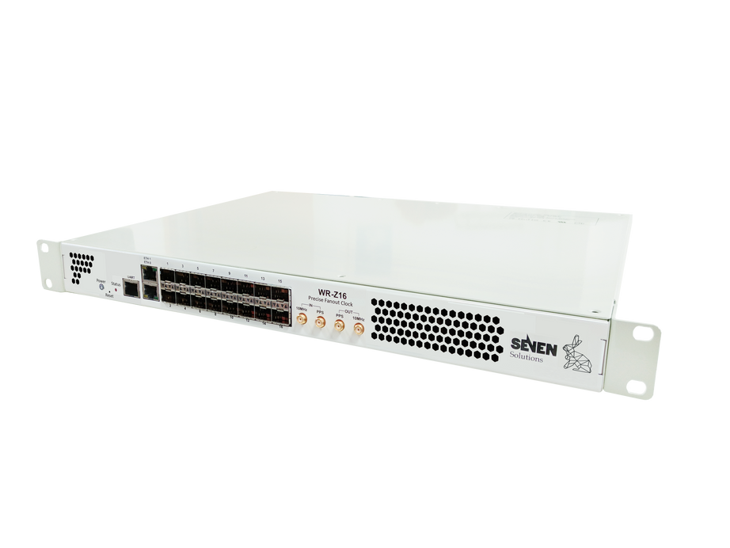
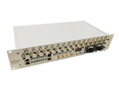
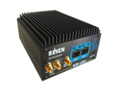
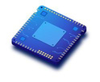
High accuracy solution ecosystem
Time servers
Distribution layer
End nodes
SecureSync
WR-Z16
WR-ZEN TP-FL
WR-ZEN TP-32BNC
VersaSync
WR-LEN
OEM Modules
HATI IP core

Slide 16
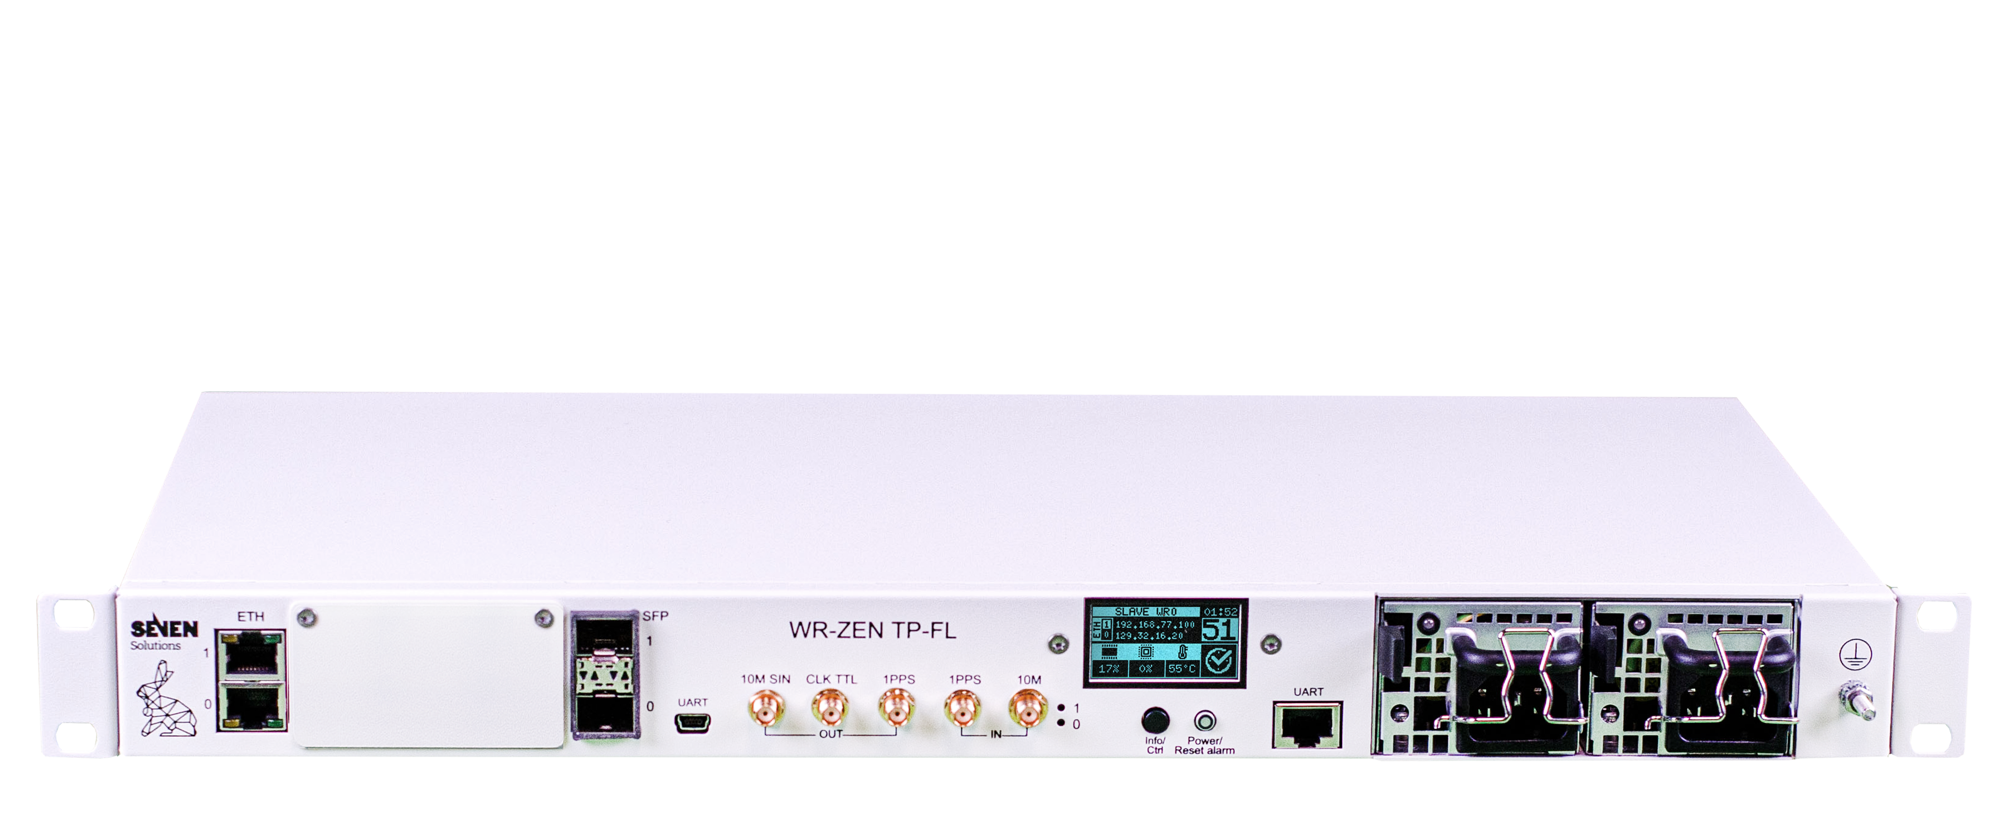
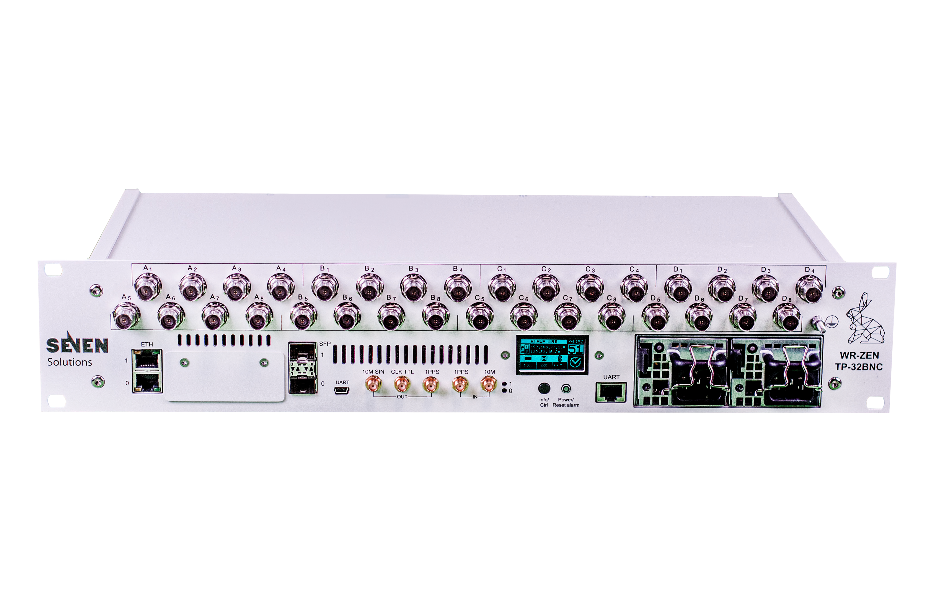
Our focus: WRZ family
Z family devices
Proprietary solution (PPSI stack is open)
Multiple form-factors on a single solution
Shared OS, timing stack and tools
Flexible and extensible using pluggable expansion boards and software licenses
WR-ZEN TP-FL
WR-ZEN TP-32BNC
WR-Z16
Main target market: Finance & Datacenters, ADG
High performance and flexibility on a multidevice software platform

Slide 17
WR devices roles
Same as other IEEE-1855 standards
WR Grandmaster (WR): This device is the first White Rabbit node connected to the time reference (i.e. SecureSync)
In this mode it will lock to the incoming 10 MHz signal and will determine the second beginning with the 1PPS input
All its optical interfaces will be automatically configured in a master role, so this device can distribute the obtained time reference to the subsequent White Rabbit devices
Boundary clock (BC): These devices receive the time reference using the White Rabbit protocol from an upstream optical interface and distribute it to downstream devices
Daisy-chains or tree topologies can be deployed
White Rabbit capable devices are required on both ends
Slave (end node): Last element of the chain, “time client”. It can be connected to a BC/GM using WR
It can behave as gateway for other timing signals or protocols (PPS, IRIG-B, PTPv2, NTP, etc…)

Slide 18
WR Time multiport Z16
Highlights
16 timing ports for WR and PTPv2 (1 Gbps)
HATI IP core support
Remote configuration and monitoring
Distance range: over 100 km using fiber
Empowered with embedded Dual-core processor
Robustness & Redundancy
Failover mechanisms & Holdover capability
Redundant hot swappable power supply & fans
Health monitoring
Low phase noise expansion card available
Future GNSS expansion: for link calibration, built-in monitoring and traceability to UTC reference
Main use: GM or BC, WR in – WR out
Up to 16 WR ports (timing fanout)

Slide 19
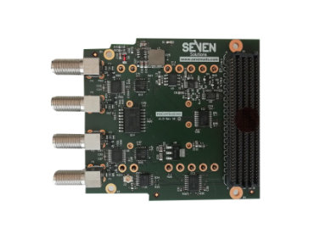
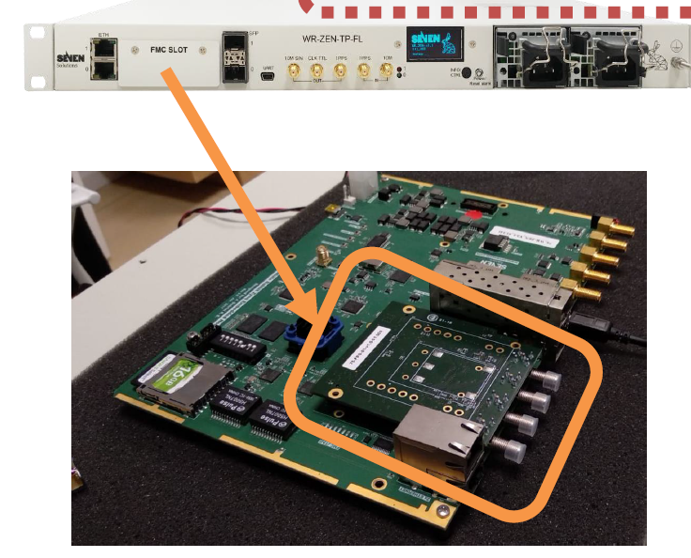
WR-ZEN TP-FL
Highlights
Standalone White Rabbit distribution
2 x WR, IEEE 1588 PTPv2 and NTP interoperability optical interfaces
Redundant White Rabbit or 10 MHz & PPS inputs
10 MHz, PPS and CLK outputs
Redundant power supply and fans
Failover mechanisms & Holdover capability
4x or 8x port SMA PPS expansion boards supported (factory installed)
Extended monitoring and management tools (Authentication, SNMP, security…)
Main use: slave - WR in – PPS out
4/8x Expansion PPS cards on a compact 1U factor

Slide 20
WR-ZEN TP-32BNC
Highlights
Standalone White Rabbit distribution
2 x WR ports compatibles with IEEE 1588-2008 (PTPv2) and NTP. IRIG-B supported on BNCs interfaces for interoperability
Up to 16 pairs of 10 MHz/xPPS outputs or 32 xPPS in a single 2U factor with sub-nanosecond accuracy alignment
Redundant power supply and fans
Failover mechanisms & Holdover capability
4x or 8x port SMA PPS expansion boards supported (factory installed)
Extended monitoring and management tools (Authentication, SNMP, security…)
Main use: slave - WR in - PPS output
Up to 32 PPS in 2U form factor,
ideal for PPS rack distribution

Slide 21
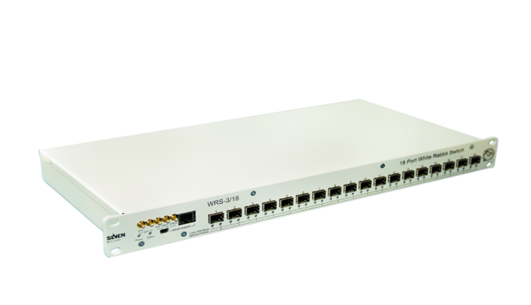
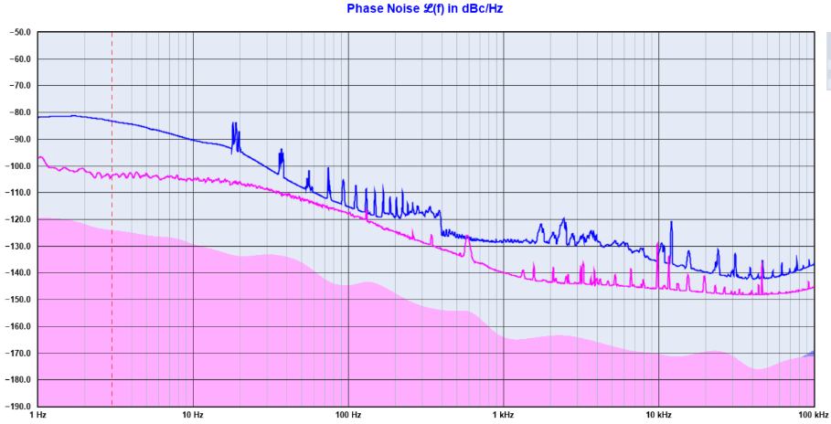
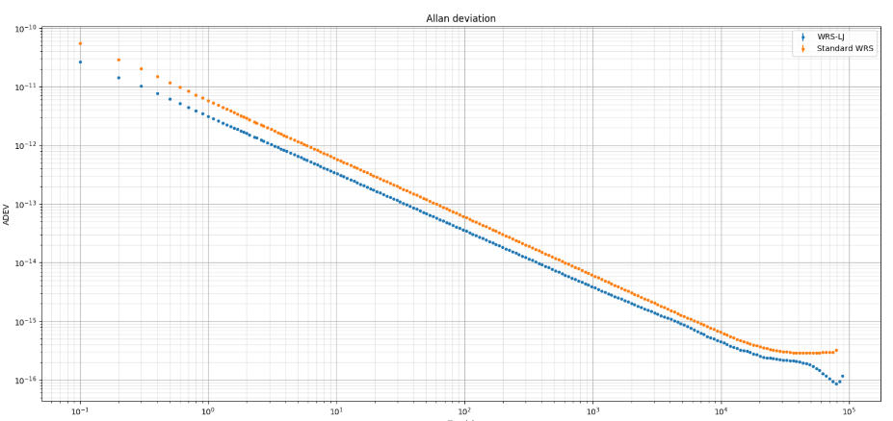
WR open switch Low Phase Noise (WRS-LJ)
Highlights
Improvements that enable its use in more demanding time and frequency distribution applications
Improved clocking design in hardware and FPGA
Enhanced stability and phase noise of clock outputs
Cleaner and more accurate 1-PPS output
Redesign of the original WR switch for improved frequency dissemination

Slide 22
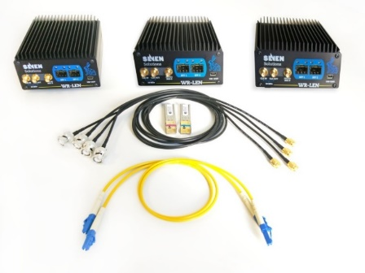
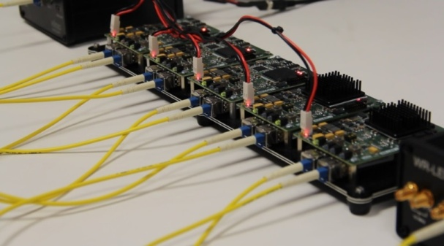
White Rabbit Lite Embedded Node
Highlights
WR Sub-nanosecond time accuracy, 10MHz/1PPS and IRIG-B support
Compact size and 100% standalone operation
Performance proven with more than 10 hops
Distance range: over 100 km using fiber
Third Ethernet copper port for data redirection
DB9 option for extra 1PPS/10Mhz and trigger generation
OEM version available for third-party partners
Compact turn-key node for accurate time transfer. No configuration. Directly running after unpacking!

Slide 23
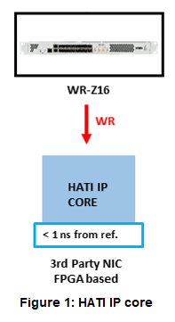
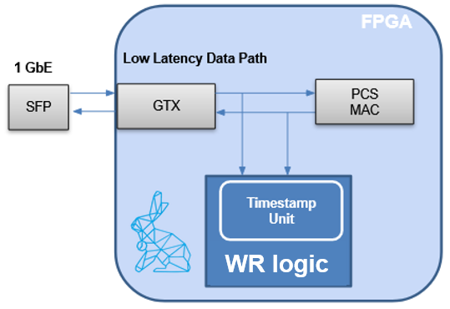
HATI/HARTI IP core for FPGAs
Highlights
High Accuracy Timing Integration in Xilinx FPGAs (family 7 to latest families)
Sub-nanosecond time accuracy on L1 switches and NICs
No need for any expensive oscillators/clocks
Distribution over fiber without calibration
Redundancy features available: HARTI
Performance without scalability frontiers
Ideal for market makers and top ADG use cases

Slide 24
03
Management tools

Slide 25
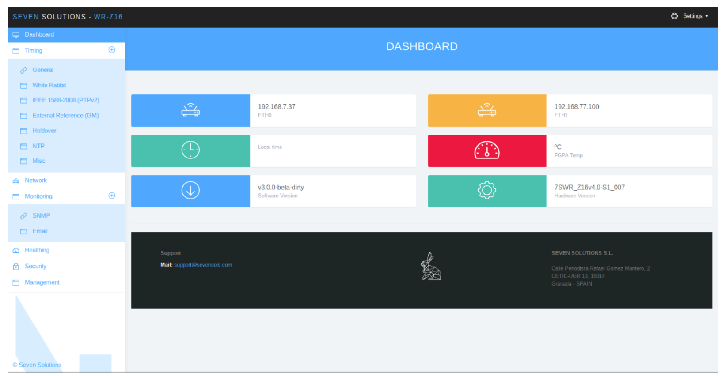
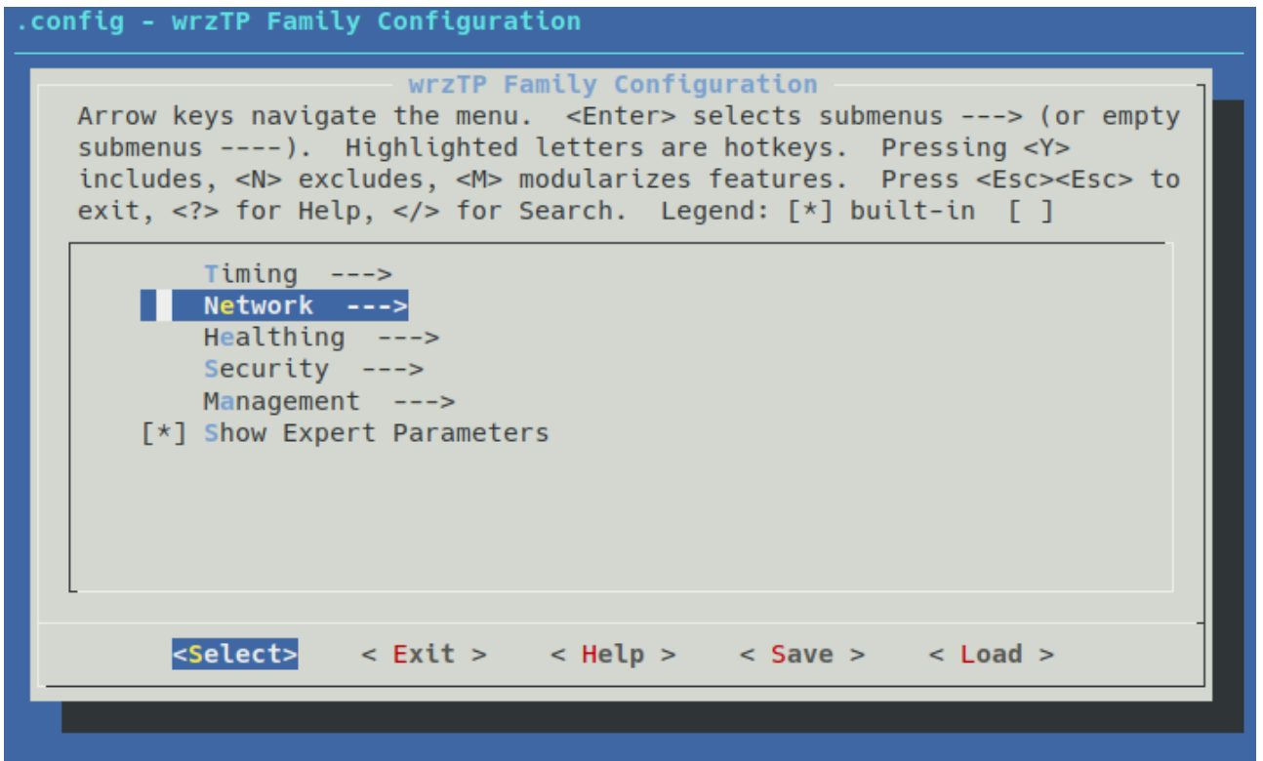
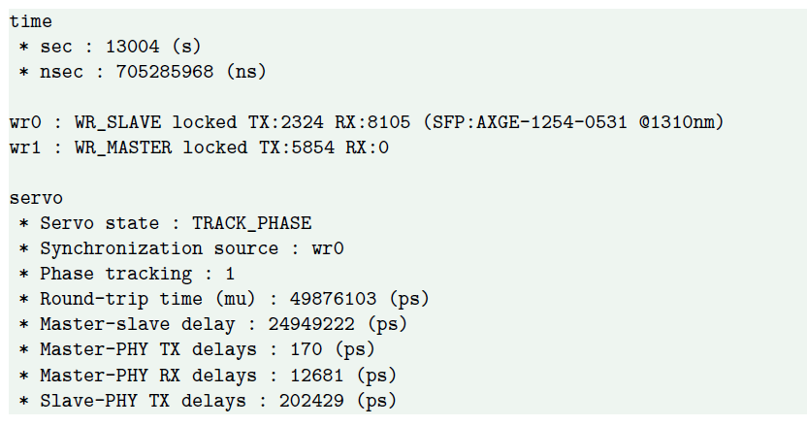
Management tools
Web interface
Accessible via IP on ETH ports
wrz_config / Kconfig
Accessible through CLI
gpa_ctrl
Accessible through CLI
Read/Write any parameter
Configuration file
Located in root
SNMP & API-REST
Under development

Slide 26
04
Use cases

Slide 27
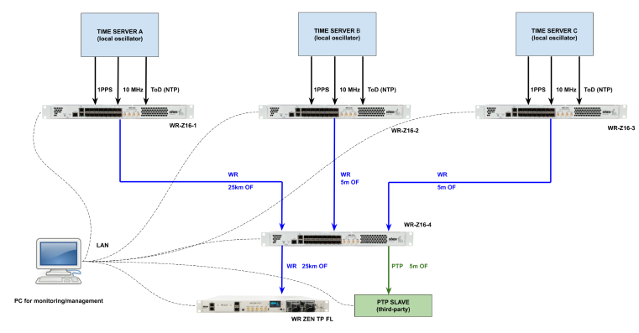
Network resiliency
Short term stability: Sub-ns accuracy and low jitter performance
Short term stability test in Holdover: Sub-us accuracy after 24h
Centralized network monitoring system
Failover algorithm integrated on WRZ products to ensure continued operation
PTP interoperability

Slide 28
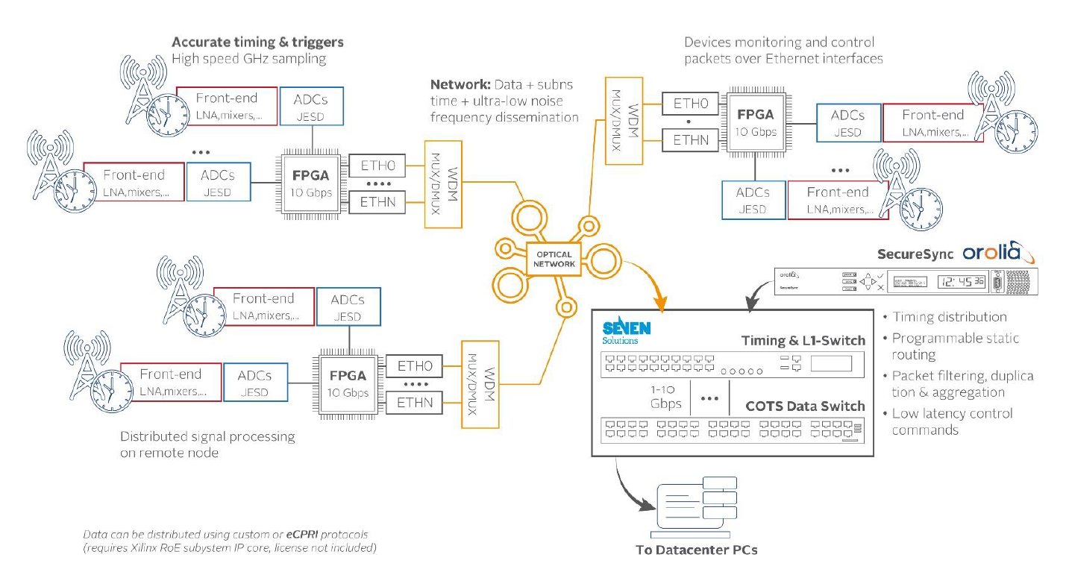
Radio over Ethernet for ADG
Distributed sensor systems relay on GNSS-based time sync
Jamming and spoofing
Cybersecurity and HA profile
Distribution of T & f with a performance better than 1 ns
IP core to be integrated in the user FPGA system
Data and timing can be provided on a single Ethernet link
Integration of possibilities
RoE fanout devices (Z16)
L1 switching
Additional resilience
Redundant Ethernet links
Rb oscillators to end nodes

Slide 29
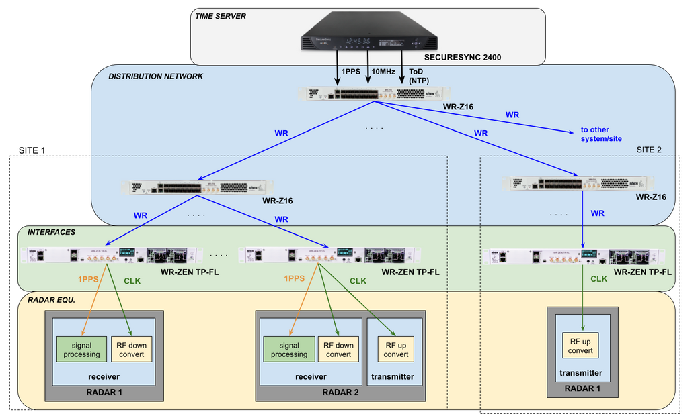
Multistatic radar solution
For optimal performance, all radar nodes require the same time and frequency reference
Frequency distribution with Low Phase Noise
Improved signal fidelity for acquisition and tracking
Sub-ns time transfer with ps-level jitter
Improved timestamping for data fusion
Support for GNSS-denied scenarios
Scalability for additional nodes and across long distances
Resiliency
Multisource failover algorithm including holdover and monitoring capabilities

Slide 30
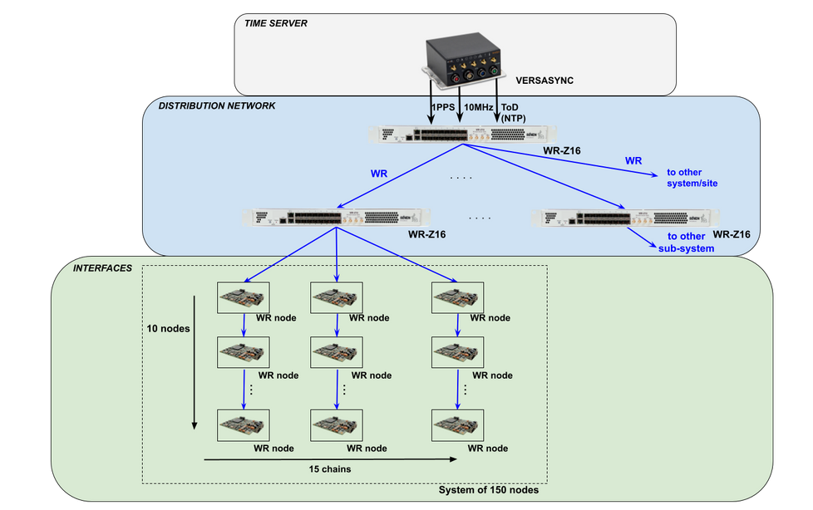
Phased array antenna
High number of radiating elements with strict requirements of time and frequency sync (sub-ns accuracy, LPN)
High performance synchronization for high number of nodes
Flexibility on network topology and scalability
Programmable phase and frequency outputs
Configurable user-controlled delay with ps resolution in 1PPS outputs
Ruggedization
Multiple integration options: HATI IP core, OEM modules, etc.

Slide 31
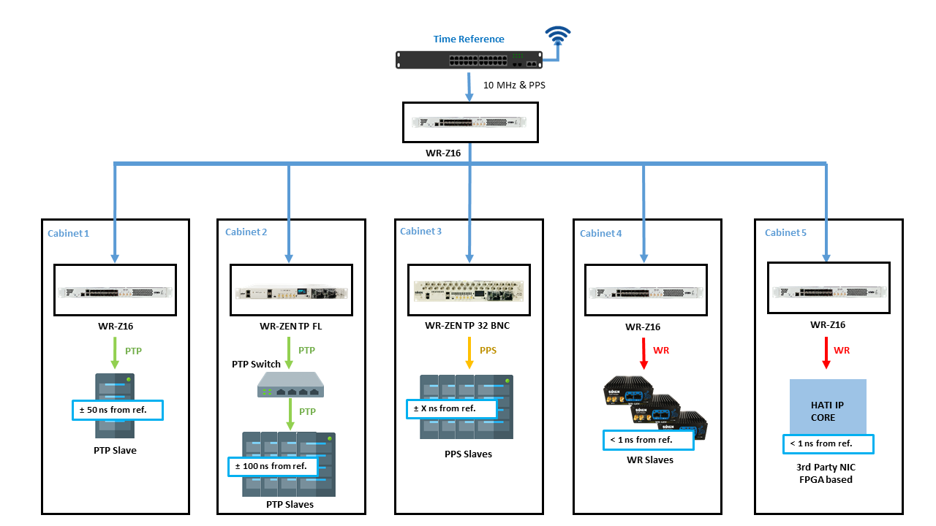
Naval applications

Slide 32
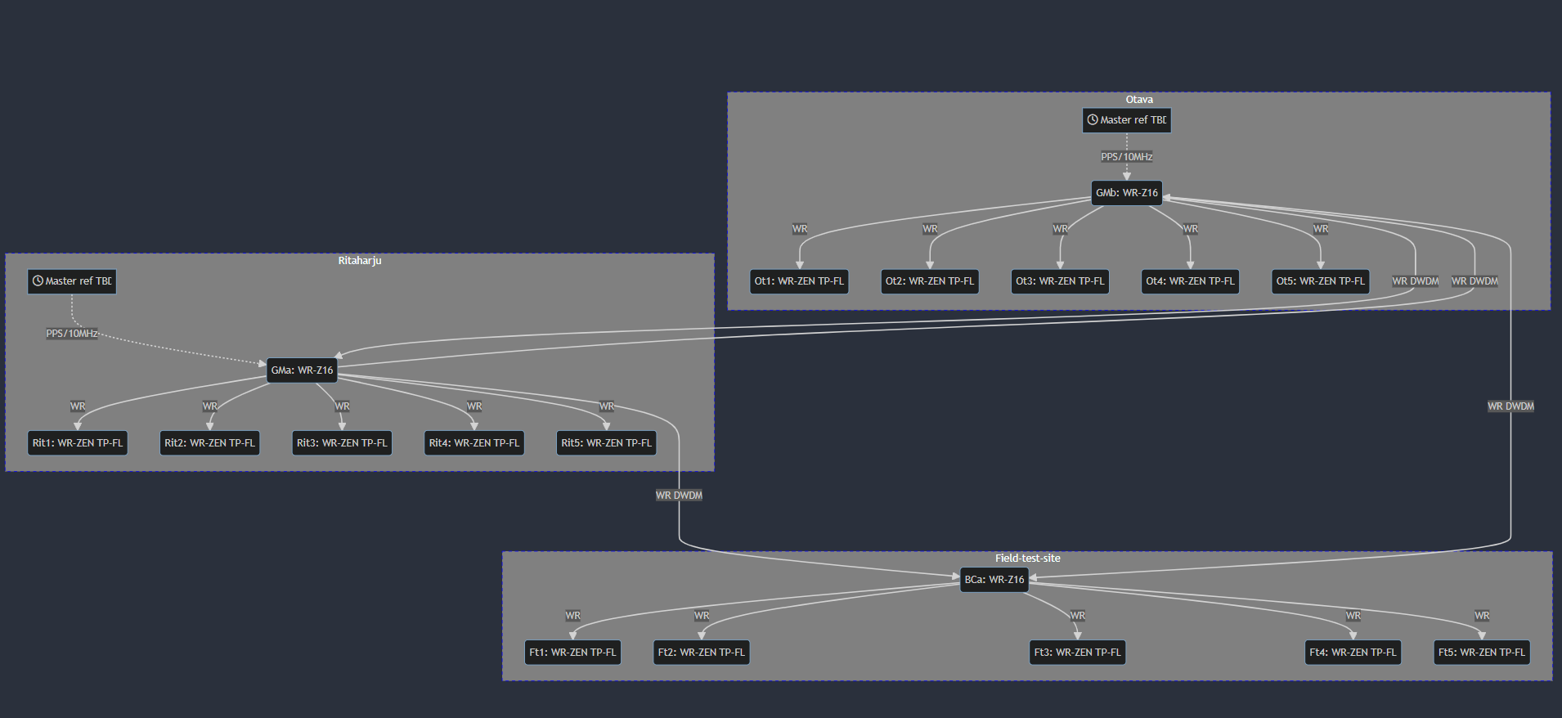
Frequency distribution (Nokia)

Slide 33
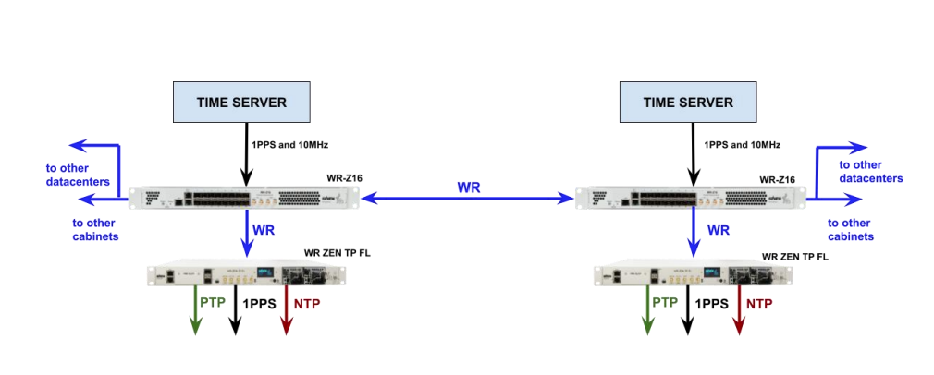
WR over dedicated fiber VS WR over shared fiber
Dedicated fiber
Simple installation
Automatic and dynamic compensation of the asymmetry
Shared fiber
Automatic asymmetry compensation is not possible
Unknown offset in the timing slave
On-site calibration methods
GNSS assisted or stand-alone
Better stability in terms of optical phenomena (equipment related)

Slide 34
05
Best practices

Slide 35
WR FAQ
Reduced bandwidth used: <10 packets/s
Bidirectional SFPs are the preferred choice. Two-fiber DWDM SFPs require calibration
WR can be used for phase-constant RF (frequency) distribution (RoE) applications
WR is non-standard profile. It is very close to the IEEE-1588-2019 High Accuracy profile (this is in fact based on WR as pre-standard). Our devices can provide other IEEE-1588v2 profiles for last-hop interoperability with accuracy equals to direct PTP grandmaster connection
Only for large distance links (+10Km), a one-time calibration is needed. Recalibration is required is network is modified
Data can be managed with WR without impacting the performance, but devices are not by default ready to handle high volume of data so most of the deployments use an independent WR network
There are some facilities with static routing topologies where customized equipment have been used to fully integrate the timing and data network, but this required NRE work to work properly

Slide 36
Best practices
WR cannot be placed as a PTP slave
The jittered correction run by PTP clock is not compatible with the precision needed for WR/HA distribution. However, a combination of PTP+SyncE as timing source, allows to re-distribute timing using WR without significant penalties
ToD is retrieved via NTP. Recommendation: setting the NTP server in every node of the topology
DWDM for long distances
Due to its poor accuracy, NTP protocol is always in Survey Mode and thus cannot actively discipline the local clock
PTP configuration besides the default profile is only available with license
SMA cables must have the same length when measuring PPS offset and phase noise

